Slide 1

The Prisoner’s Dilemma

Slide 2
The Prisoner’s Dilemma
 | B cooperates | B defects (rats)
A cooperates | A: 1 year B: 1 year | A: 3 years B: goes free
A defects (rats) | A: goes free B: 3 years | A: 2 years B: 2 years

Slide 3
The Theory of Games
Zero-sum games
Chess
The fight for page rank
Nonzero-sum games
Prisoner’s Dilemma

Slide 4
The Prisoner’s Dilemma
Defect dominates cooperate.
A single Nash equilibrium (defect/defect)
(No one can unilaterally improve his position)
 | B cooperates | B defects (rats)
A cooperates | A: 1 year B: 1 year | A: 3 years B: goes free
A defects (rats) | A: goes free B: 3 years | A: 2 years B: 2 years
Notes:
From wikipedia: The Prisoner's Dilemma was originally framed by Merrill Flood and Melvin Dresher working at RAND in 1950. Albert W. Tucker formalized the game with prison sentence payoffs and gave it the "Prisoner's Dilemma" name (Poundstone, 1992).

Slide 5
The Prisoner’s Dilemma
Defect dominates cooperate.
A single Nash equilibrium (defect/defect)
(No one can unilaterally improve his position)
A single Pareto optimum
(There exists no alternative that is better for at least one player and not worse for anyone.)
 | B cooperates | B defects (rats)
A cooperates | A: 1 year B: 1 year | A: 3 years B: goes free
A defects (rats) | A: goes free B: 3 years | A: 2 years B: 2 years
The Nash equilibrium is not Pareto optimal.
Notes:
From wikipedia: The Prisoner's Dilemma was originally framed by Merrill Flood and Melvin Dresher working at RAND in 1950. Albert W. Tucker formalized the game with prison sentence payoffs and gave it the "Prisoner's Dilemma" name (Poundstone, 1992).

Slide 6
The Money Dilemma
 | B cooperates | B defects
A cooperates | A: $ 100 B: $ 100 | A: $ 0 B: $ 200
A defects | A: $ 200 B: $ 0 | A: $ 50 B: $ 50
Notes:
Use this to idealize the question and get rid of issues like loyalty, will they break my knee caps, etc.

Slide 7
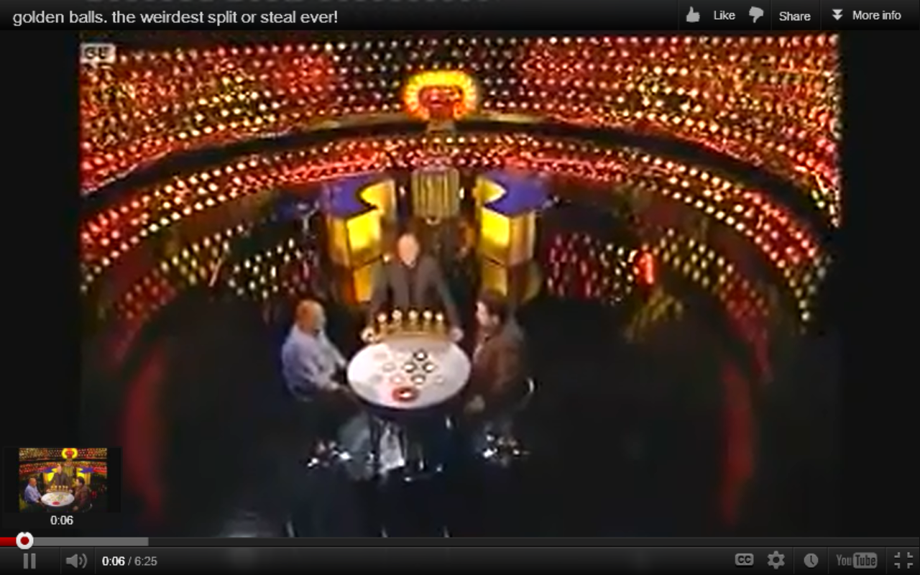
What Will People Actually Do?
http://articles.businessinsider.com/2012-04-21/news/31377623_1_contestants-split-prisoner-s-dilemma
Notes:
Watch the video. Is the result what we’d expect from Dan Ariely? These people had to look each other in the eye and make a promise.

Slide 8
Nuclear Disarmament
 | B Disarms | B Arms
A Disarms | safer and less expense for both | A saves money but is wiped out by B
A Arms | B saves money but is wiped out by A | major expense for both and riskier world
Notes:
Red is a Nash equilibrium. Green is a Pareto optimum.

Slide 9
Sports Doping
 | B is clean | B dopes
A is clean | A: clean and honest competition | A: at competitive disadvatage to B
A dopes | A: at competitive advantage over B | A: dishonest (but balanced) competition

Slide 10
Externalities
 | B is clean | B pollutes
A is clean | A: Small expense; Clean environment; No competitive advantage | A: Small expense; Competitive disadvantage to B
A pollutes | A: No expense; Competitive advantage over B | A: No expense; No competitive disadvantage. Horrible environment; Cost of disasters high.
Notes:
Lights in the Tunnel points out that free market doesn’t do a good job of dealing with externalities. Something “external”, like the government, is required.

Slide 11
Jobs
 | B keeps jobs | B nukes jobs
A keeps jobs | A: Payroll expense No competitive advantage Plenty of customers | A: Payroll expense At competitive disadvantage to B Some customers
A nukes jobs with technology | A: Lower payroll expense At competitive advantage over B Some customers | A: Lowest payroll expense No competitive advantage No customers
Notes:
What to do here to prevent us landing in nukes/nukes, where no one can make any money because there are no customers?

Slide 12
The prisoner's dilemma is a paradox in decision analysis in which two individuals acting in their own self-interests do not produce the optimal outcome. The typical prisoner's dilemma is set up in such a way that both parties choose to protect themselves at the expense of the other participant.

Slide 13
More Examples

Slide 14
More Examples
Corporate advertising

Slide 15
More Examples
Corporate advertising
Climate and environmental protection

Slide 16
More Examples
Corporate advertising
Climate and environmental protection
Intercollegiate athletics

Slide 17
More Examples
Corporate advertising
Climate and environmental protection
Intercollegiate athletics
Cheating on tests

Slide 18
More Examples
Corporate advertising
Climate and environmental protection
Intercollegiate athletics
Cheating on tests
Immediate vs. long term goals

Slide 19
More Examples
Corporate advertising
Climate and environmental protection
Intercollegiate athletics
Cheating on tests
Immediate vs. long term goals
Stealing software
http://www.nytimes.com/1986/06/17/science/prisoner-s-dilemma-has-unexpected-applications.html

Slide 20
Combining Approaches: Just Consequentialism
Choosing the “right” action is a
Utilitarianism asks to maximize good.
Rights of Persons provides constraints on that process.
Notes:
Just consequentialism James Moor Need to briefly introduce the idea of Rights of Persons – we can’t optimize for the masses while, for example, enslaving some people.

Slide 21
Constrained Optimization

Slide 22
Where’s the highest point within the marked region?

Slide 23

Now, where’s it the highest point within the marked region?

Slide 24
Either:
1. The optimum is not affected by small movements in the constraints
Or
2. The optimum sits on the constraints and is totally affected by small changes.

Slide 25
So what?
What’s this have do with prisoner’s dilemma?

